Slide 1
Clean Coding Practices
CSE - 214
Prepared by
Ishrat Jahan

Slide 2
Any fool can write code that a computer can understand.
Good programmers write code that humans can understand.

Slide 3
What is/Why Clean Code?
Readability
Maintainability
Collaboration
Bug Reduction
Efficiency

Slide 4
Key Factors
Effectiveness
Efficiency
Simplicity

Slide 5
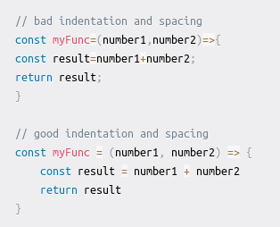
Best Practices and Principles
Format and Syntax
Keep it consistent
Follow the standards
Take care of indentations, spaces, and
cases

Slide 6
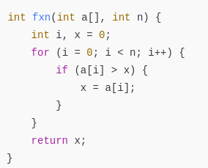
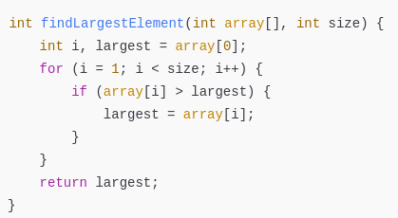
Best Practices and Principles
2. Naming Conventions
Use meaningful, self-explanatory names

Slide 7
Best Practices and Principles
3. Comments
Comments are usually created when the author realizes that his or her code isn’t intuitive or obvious.
In such cases, comments are like a deodorant masking the smell of fishy code.
The best comment is a good name for a method or class
Comments can be useful:
• To explain why
• When explaining complex algorithms

Slide 8
Best Practices and Principles
4. SRP (Single Responsibility Principle)
A function should do one thing and do it well
Keep functions and methods concise

Slide 9
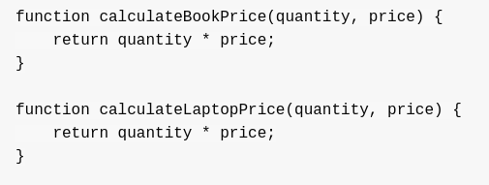
Best Practices and Principles
5. DRY (Do not Repeat Yourself)
A function should do one thing and do it well
Keep functions and methods concise

Slide 10

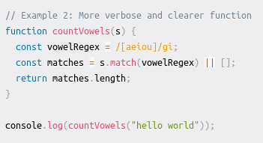
Best Practices and Principles
6. Conciseness vs Clarity

Slide 11
Best Practices and Principles
7. Reusability
8. Single Source of Truth
Avoid hard-coding numbers
Ensure that constants or or config is stored only one place in the codebase

Slide 12
Best Practices and Principles
9. Documentation
10. Refactoring
Already covered!

Slide 13
Happy Coding!

